Slide 1



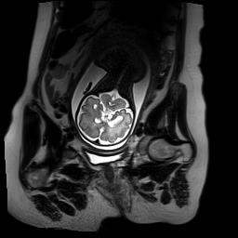
A Deep Learning Approach for Image Quality Assessment of Fetal Brain MRI
Sayeri Lala, Nalini Singh, Borjan Gagoski, Esra Turk, P. Ellen Grant, Polina Golland, Elfar Adalsteinsson

Slide 2
Declaration of Financial Interests or Relationships
Speaker Name: Sayeri Lala
I have no financial interests or relationships to disclose with regard to the subject matter of this presentation.

Slide 3
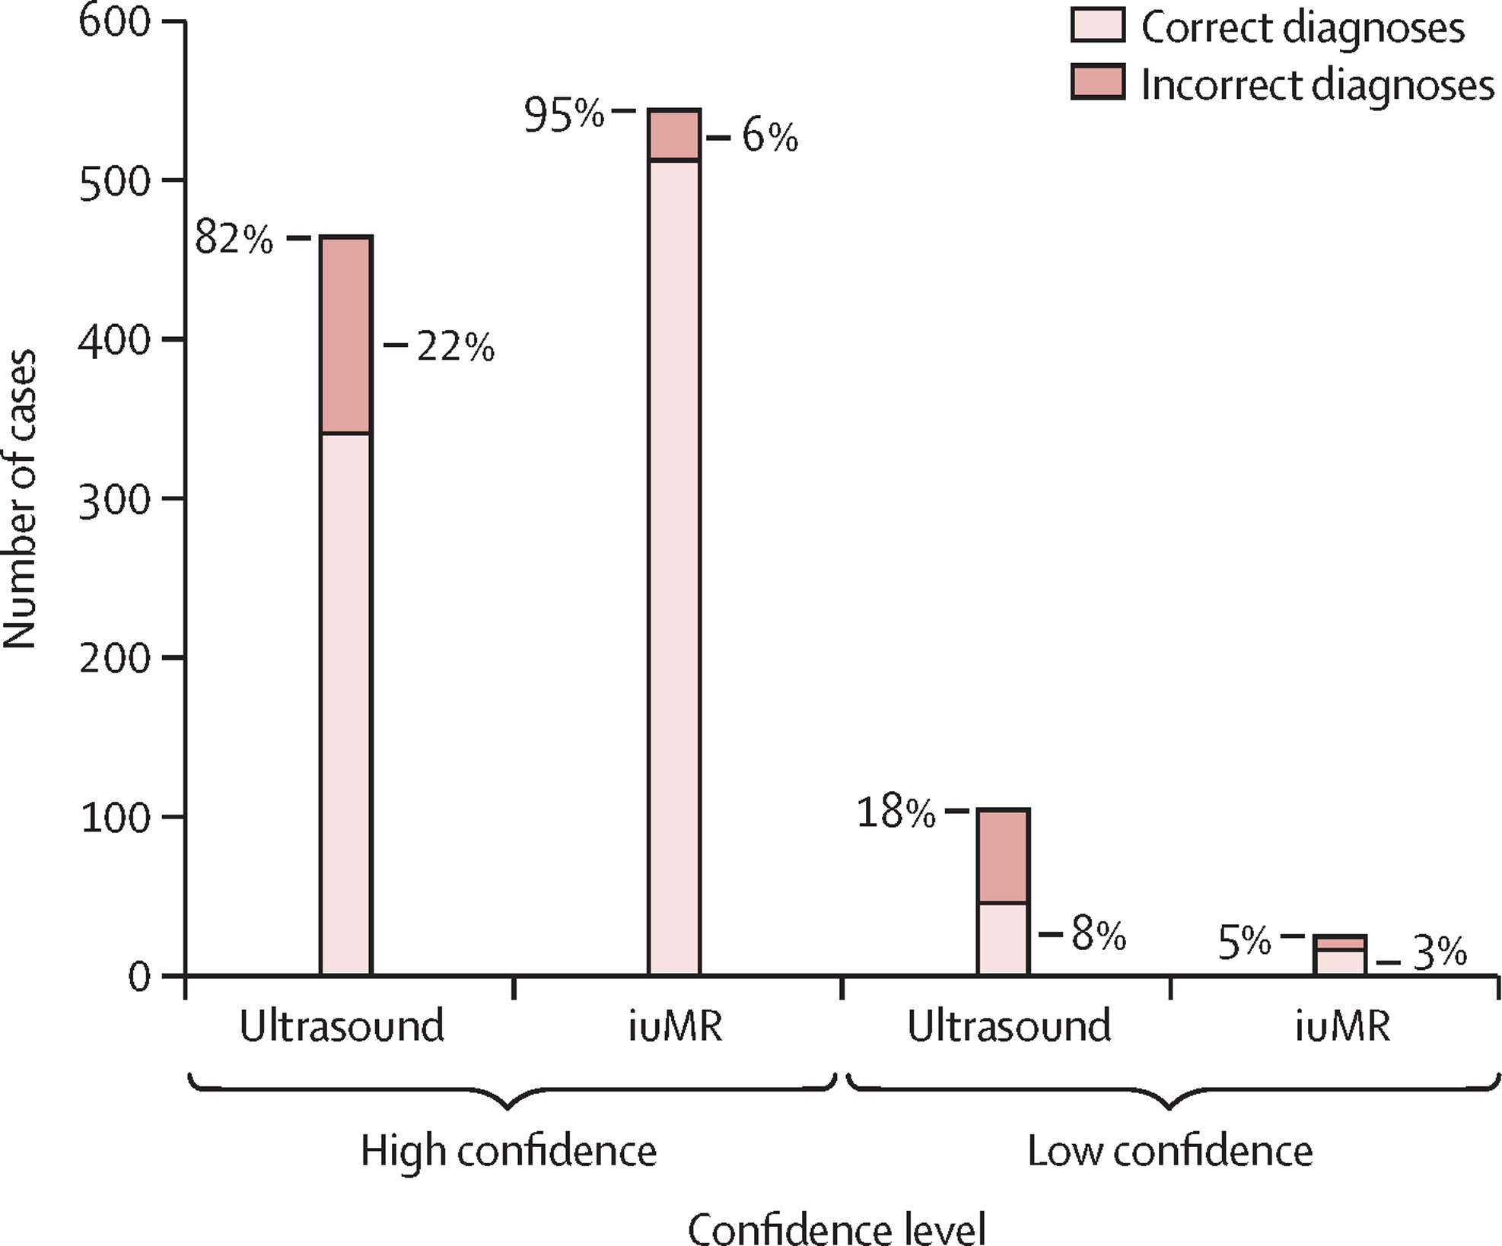
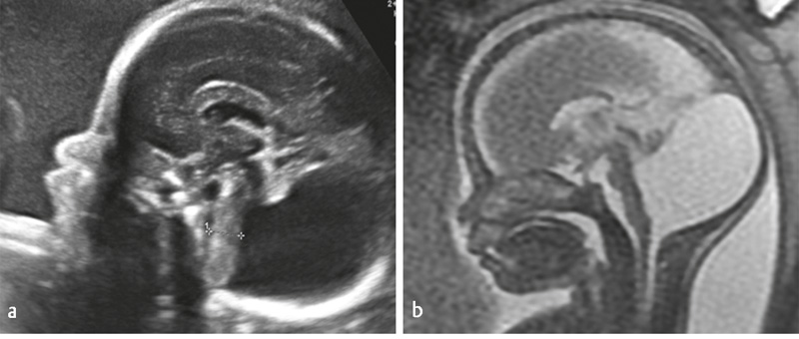
Fetal Brain MRI complements Ultrasound in diagnosing brain abnormalities
MRI
Ultrasound
Griffiths, Paul D., et al. doi: 10.1016/S0140-6736(16)31723-8
Gat, I, et al. doi: 10.1055/s-0034-1384935
Pasupathy D, et al. doi: 10.1111/1471-0528.15620
Jarvis, Deborah A., et al. doi: 10.1002/jmri.26316

Slide 4
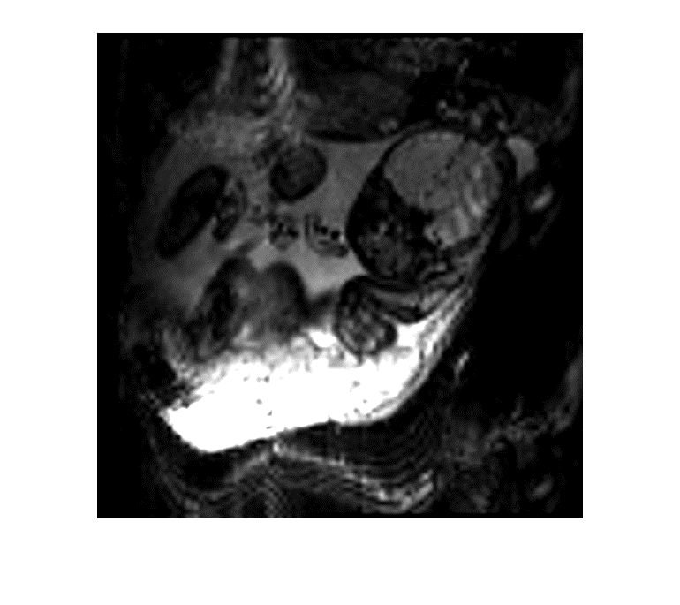
Fetal motion is rapid and not periodic
BOLD EPI
Temporal resolution: 3.5s
Bold
Chapman, Teresa, et al. doi: 10.1007/s00247-018-4236-3
Gholipour, Ali, et al. doi: 10.1002/cmr.a.21321
Malamateniou, C., et al. doi: 10.3174/ajnr.A3128.
Notes:
Occurring on the order of ms-s
Motion can be relatively large e.g., rotation, translation

Slide 5
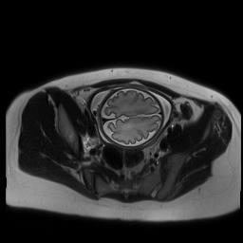
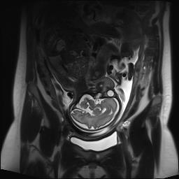
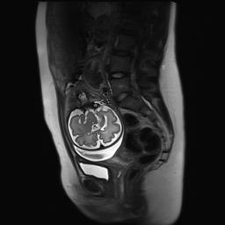
Protocol for imaging a T2W brain volume
Gholipour, Ali, et al. doi: 10.1002/cmr.a.21321
Jarvis, Deborah A., et al. doi: 10.1002/jmri.26316
Notes:
Need for fast imaging techniques

Slide 6
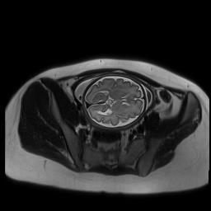
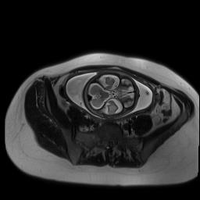
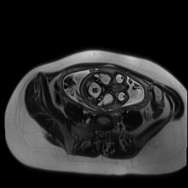
Protocol for imaging a stack
~500 ms
+ 1-2s
HASTE sequence
Stack acquired in ~1 min.
Gholipour, Ali, et al. doi: 10.1002/cmr.a.21321
Jarvis, Deborah A., et al. doi: 10.1002/jmri.26316
Notes:
Slice by slice
SST2W sequence, aka HASTE, SSFSE, SS-TSE. I’ll refer to these as HASTE in the talk.
Trades off quality for speed

Slide 7
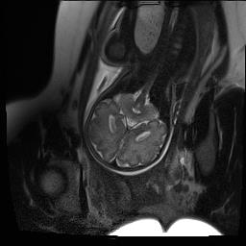
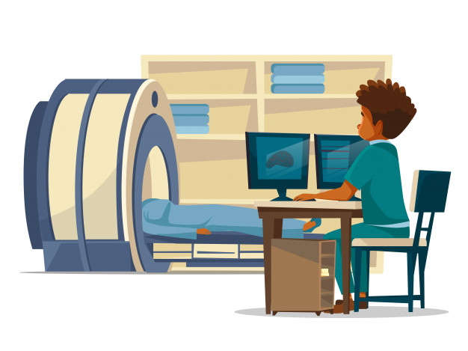
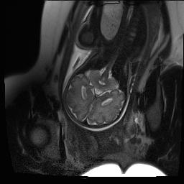
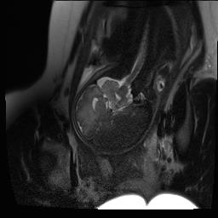
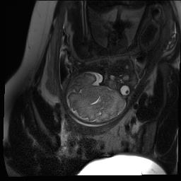

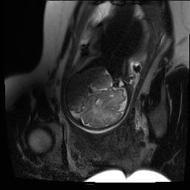

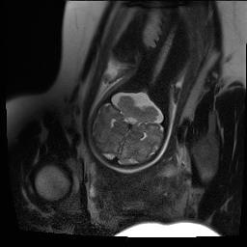
Challenges in T2W Fetal Brain MRI Clinical workflow
6-12+ stacks
Reacquire
automated Image Quality Assessment (IQA)
Kainz, Bernhard, etl al. doi: 10.1109/TMI.2015.2415453
Notes:
Despite the use of fast imaging techniques, , this protocol is still vulnerable to inter and intra slice motion artifacts
So stacks generally have a couple poor quality slices so in these cases technicians reacquire the entire stack
Consequently, Often mothers can get 6-12+ stacks acquired
We explore prospective approaches to detect poor quality slices by developing an automated image quality assessment classifier .
this could help technicians know what data to reacquire.

Slide 8
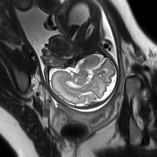
Scalp
Skull
Cortex
White matter
Cerebral Spinal Fluid
Notes:
Diagnostic quality

Slide 9
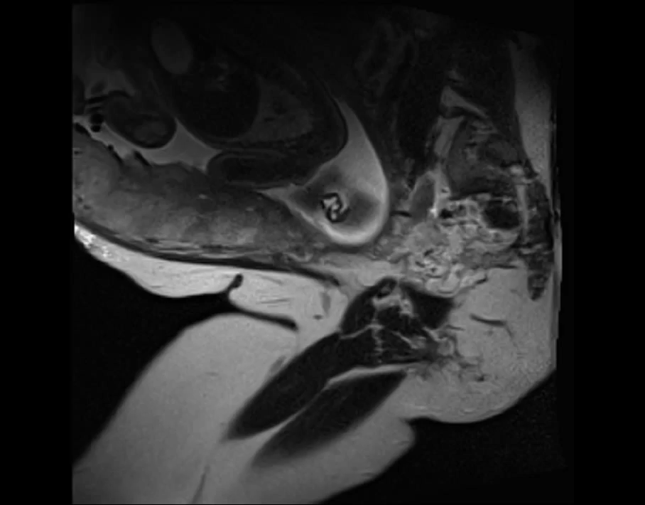

Slide 10
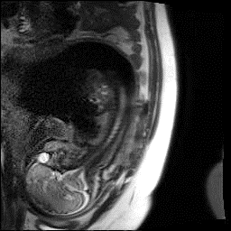
Blurring
Notes:
Motion is the dominant source of artifacts.
Motion can occur during readout
Manifests as blurring, noise in the image.

Slide 11
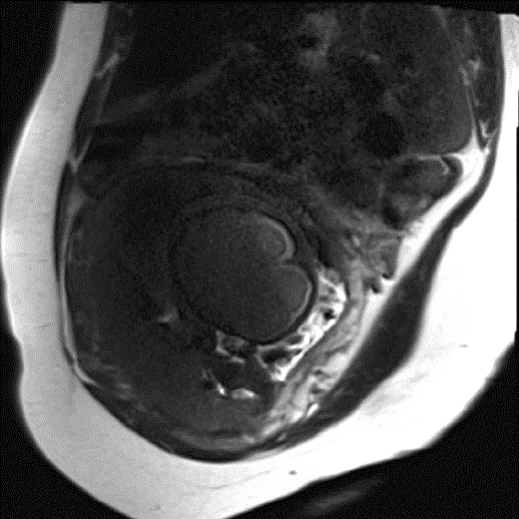
Non-uniform signal void

Slide 12
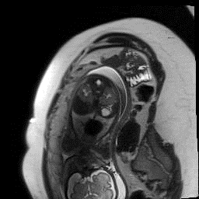
Fetal brain not in Field of View

Slide 13
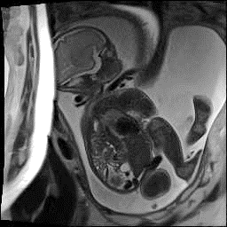
Aliasing

Slide 14
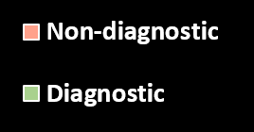
Dataset Characterization
32 mothers with singleton healthy pregnancies
~26 slices
~6 stacks
Notes:
First part of the work involved preparing a labeled slice quality dataset
Average subject profile based on our dataset
Recall that if 1 slice is bad, the entire stack is bad

Slide 15
Dataset Characterization
32 mothers with singleton healthy pregnancies
4933 slices
192 stacks
9%
35%

Slide 16
Dataset Characterization
32 mothers with singleton healthy pregnancies
Slice imaging parameters
HASTE sequence
Echo Time of 115 ms
Repetition Time of 1.6 s
Field of view of 31cm
Voxel size of 1.2x1.2x3 mm³
4933 slices
9%

Slide 17
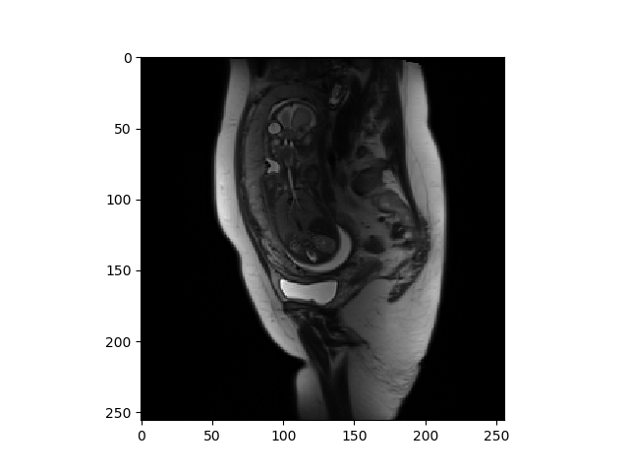
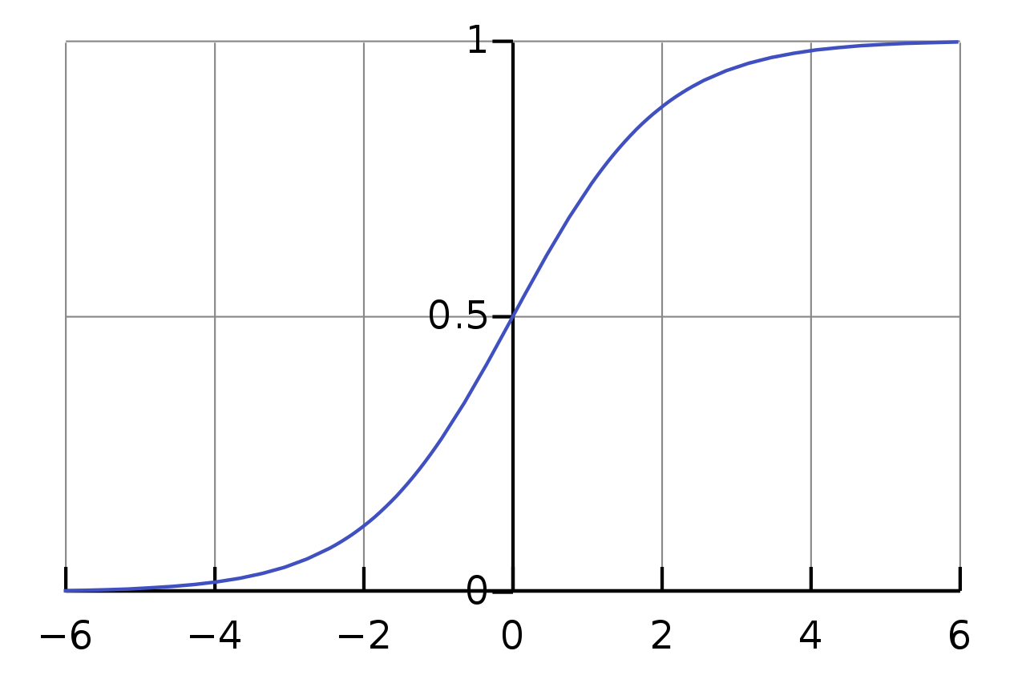
Convolutional Neural Networks for IQA classifier
256x256x3
64
3x3 Conv-ReLu
Fully Connected-ReLu
128
2x2 Max Pooling
Sigmoid
256
512
512
4096
4096
1
Trained with stochastic gradient descent, dropout,
class weighted binary cross entropy loss
Simonyan, Karen, et al. arXiv preprint arXiv:1409.1556 (2014).
Esses, Steven J., et al. 10.1002/jmri.25779
Sujit, Sheeba J, et al. 10.1002/jmri.26693
Li J, et al (2018) ISMRM-ESMRMB 2018.
Notes:
Relevant literature – IQA for MRI
Experimented with several architectures and found transfer learning boosted performance
We adapted the VGG-16 trained on ImageNet
Input slice image: adapt it for VGG
Output: classification score between 0,1 indicating if slice is good/bad quality
The architecture : conv + pooling + FC. # filters in the conv layers is shown.
Output: single neuron with sigmoid function without output between 0 to 1.
Training
SGD, dropout for the FC, cost sensitive learning to account for class imbalance cost sensitive

Slide 18
Dataset Characterization
32 mothers with singleton healthy pregnancies
4933 slices
9%
Dataset Partition | # subjects | # slice images | % Non-diagnostic quality
Train | 19 | 2955 | 9
Validation | 6 | 691 | 11
Test | 7 | 1138 | 10
Notes:
Partitioned in train/val/test set with 60/20/20 split
Each partition had roughly same fraction of non-diagnostic quality slices.

Slide 19
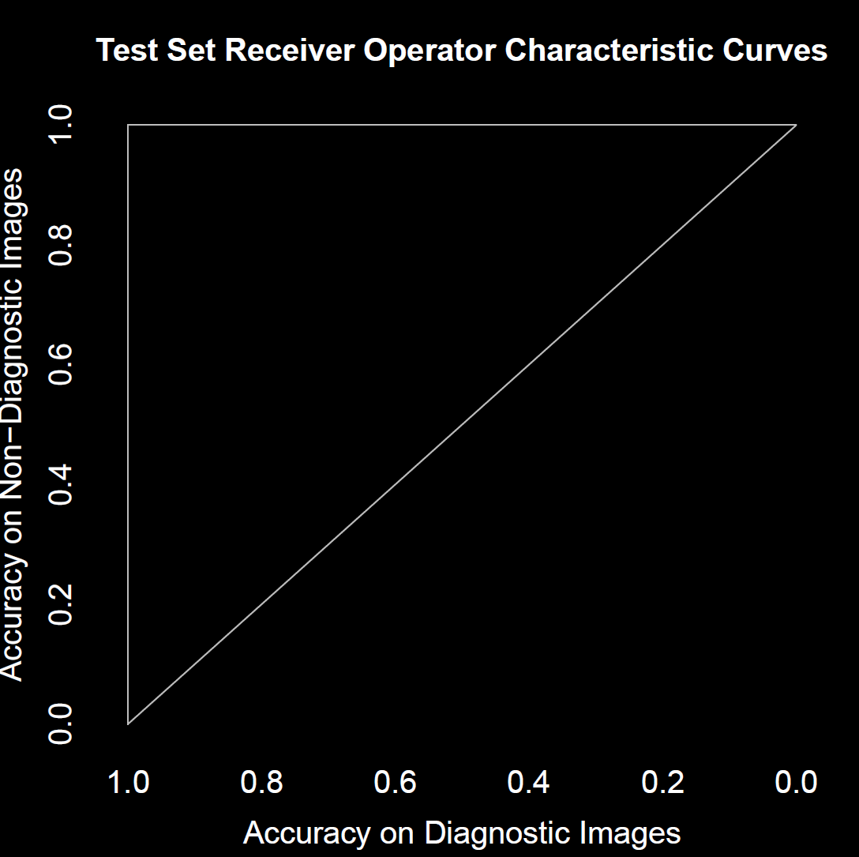
Ideal
Random guess baseline

Slide 20
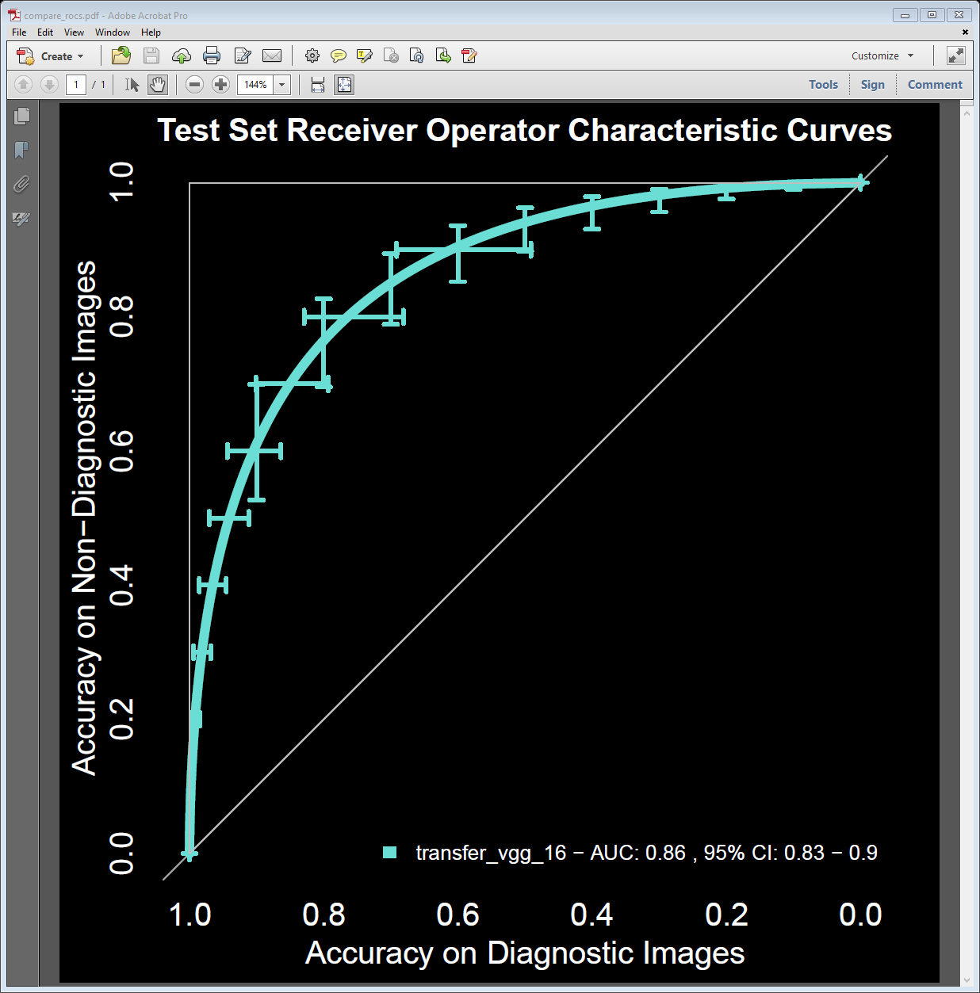
Notes:
1. To further understand classification performance: sample classifications and saliency maps to understand what features drive classification decision.

Slide 21
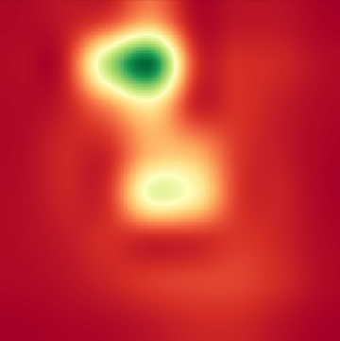
Grad-CAM for saliency maps
Selvaraju, Ramprasaath R., et al. arXiv: 1610.02391.
Adebayo, Julius, et al. arXiv:1810.03292.
CNN
for IQA
Grad-CAM
Notes:
1. Grad-CAM aka gradient weighted class activation mapping to identify what parts of image drive classification decision

Slide 22
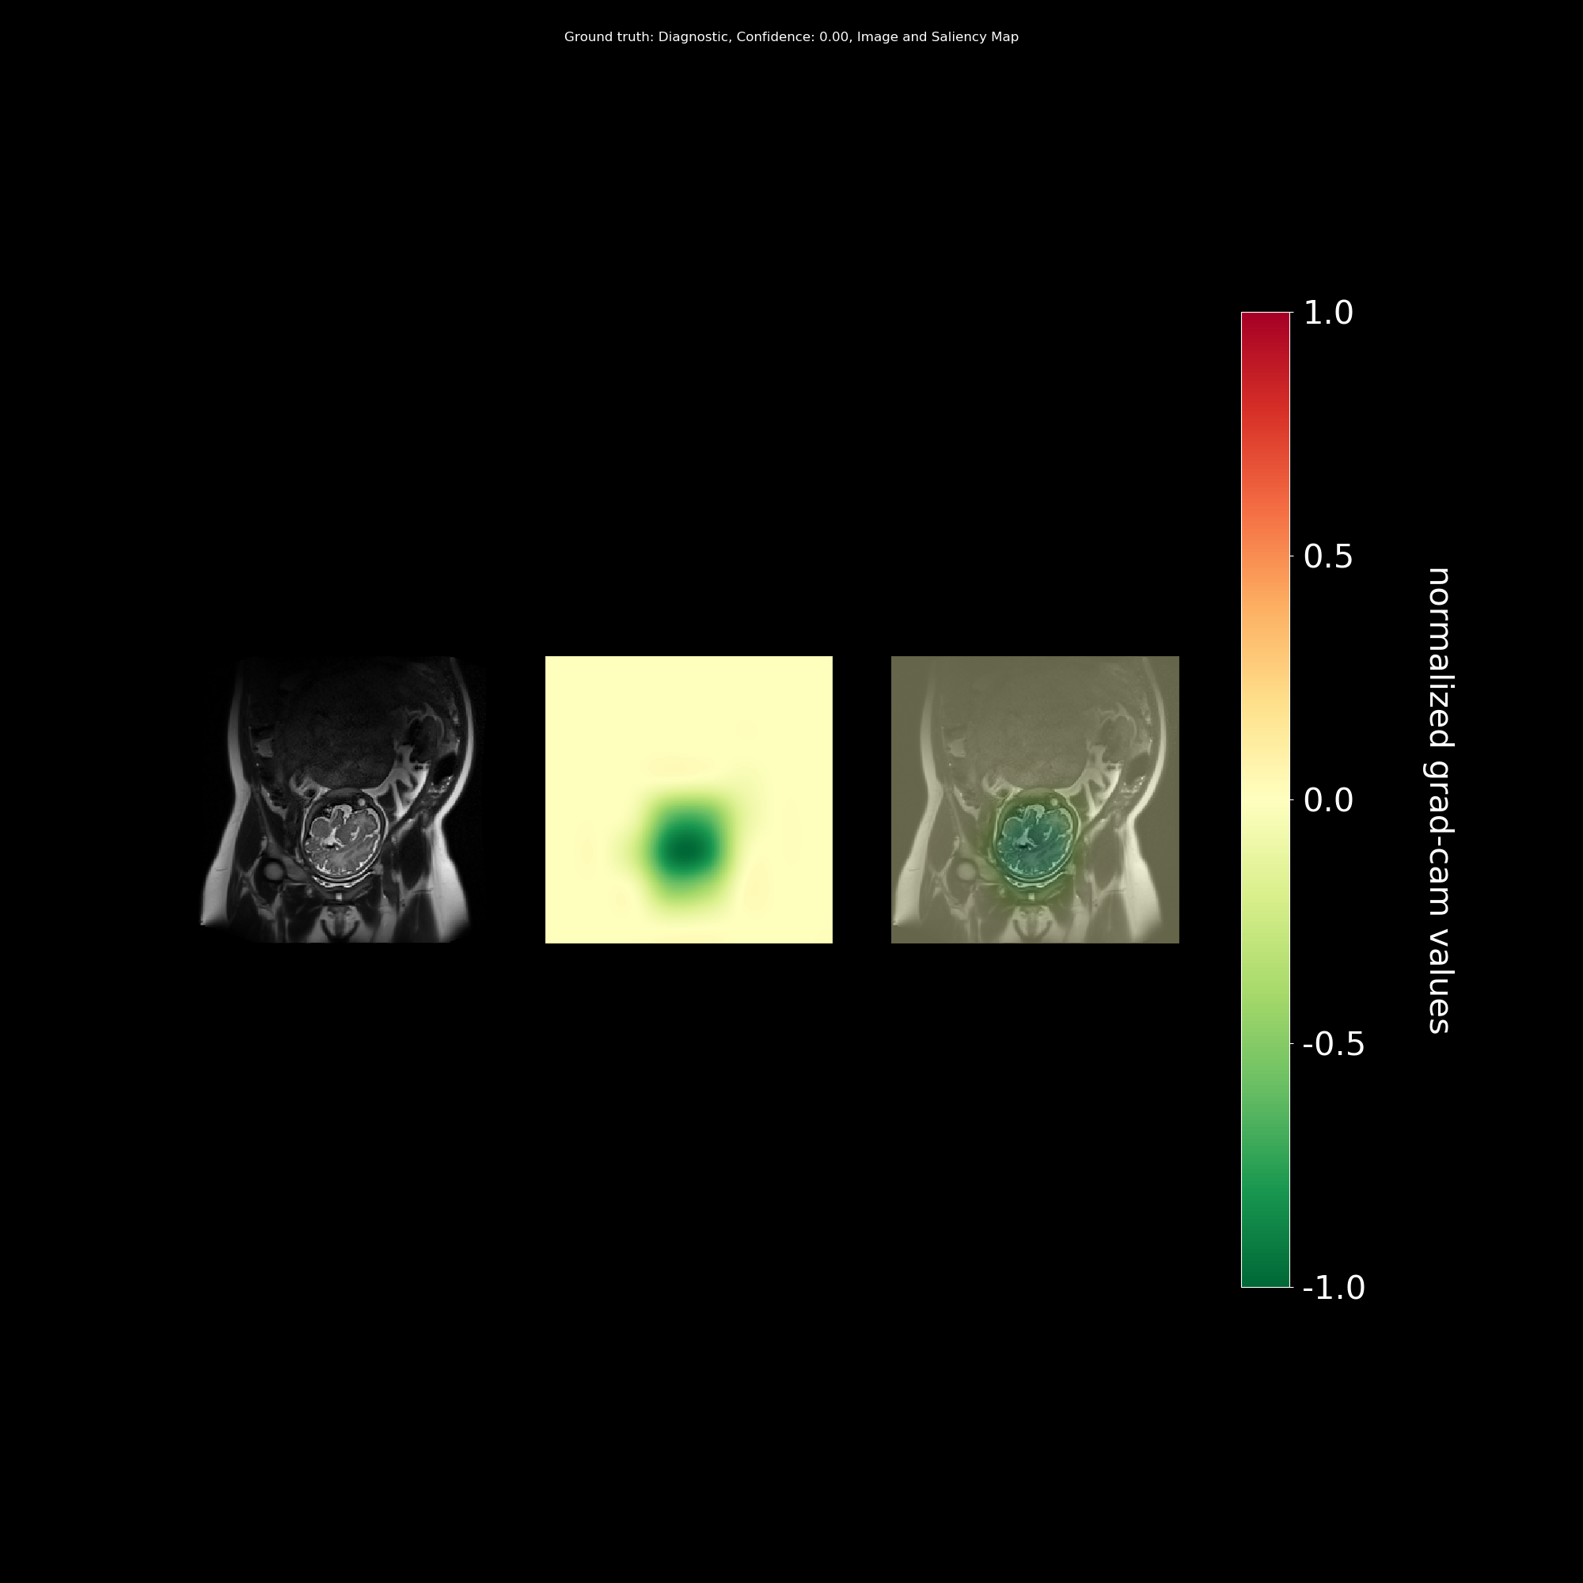
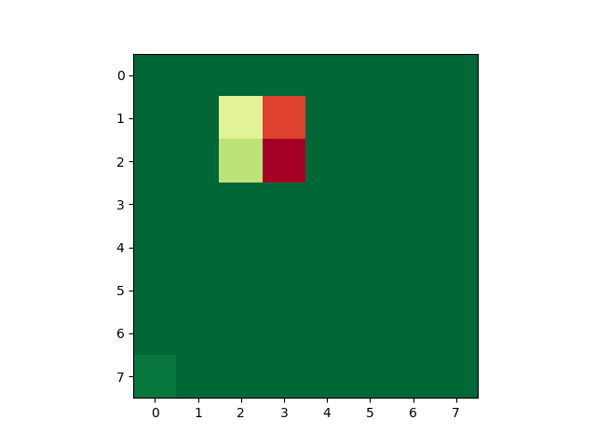
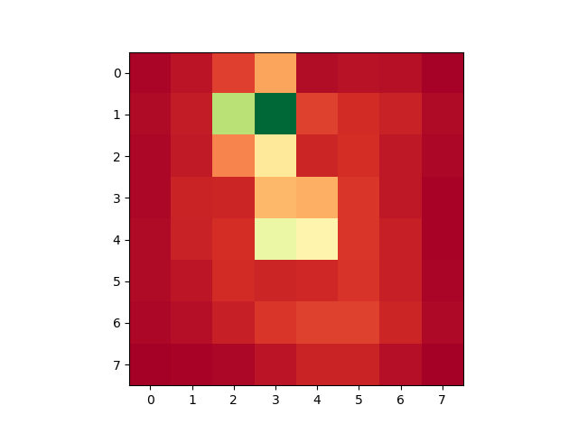
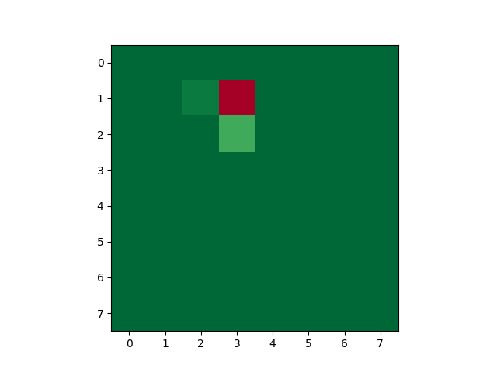
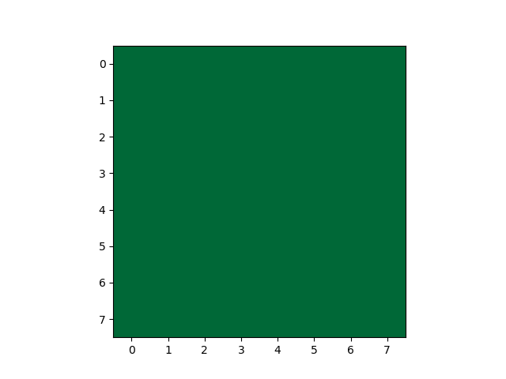







Grad-CAM for saliency maps
Normalized Grad-CAM activations
Selvaraju, Ramprasaath R., et al. arXiv: 1610.02391.
Adebayo, Julius, et al. arXiv:1810.03292.
CNN_IQA
$$256×256×3$$
$$a_{k}=\frac{1}{Z}\sum_{i}{\sum_{j}{\frac{∂y}{∂A_{ij}^{k}}}}$$
Final Convolutional Layer
Feature maps
A¹
A²
A^{N}
$$256×256$$
$$\left[\begin{aligned}{ a}_{1} \\ a_{2} \\ … \\ a_{N}\end{aligned}\right]$$
…
$$m×m$$
$$=$$
$$m×m$$
Notes:
High level: project activations from final conv layer onto original image
Each feature map is weighted according to its importance and then these weighted maps are summed to get a final map
The final map is upsampled to the original image size
The importance weight for a map is computed by taking the average gradient of the classifier score with respect to each coordinate of the feature map
Ill now show sample smaps on our dataset

Slide 23
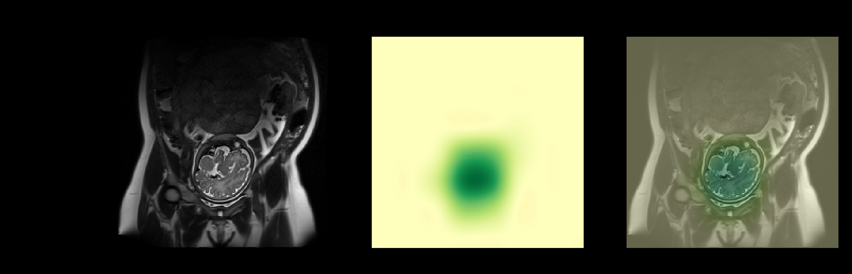
Normalized Grad-CAM activations
True label
CNN_IQA
score and label
Grad-CAM
Grad-CAM overlaid
0.00
Notes:
Walk through each column
Classifier decision is driven by negative activations coming from the brain. Negative activations push classification decision towards good quality.

Slide 24
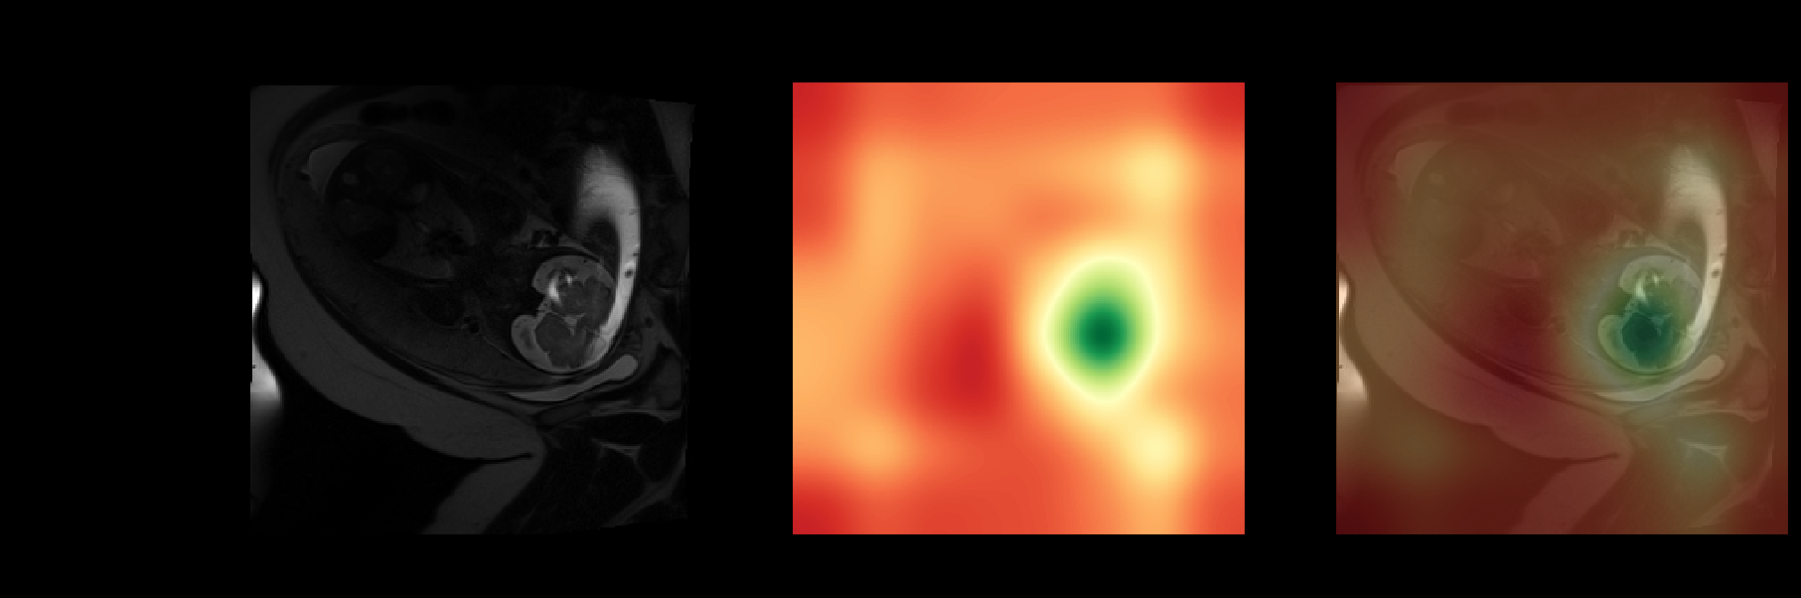

Normalized Grad-CAM activations
True label
CNN_IQA
score and label
Grad-CAM
Grad-CAM overlaid
0.93
Notes:
Classification decision is driven by positive activations coming from rest of the image, with some negative activations coming from part of the brain. Recall that positive activations push the classification towards poor quality.
Also note that the positive activations are spread over the image and not localized to the artifact.

Slide 25
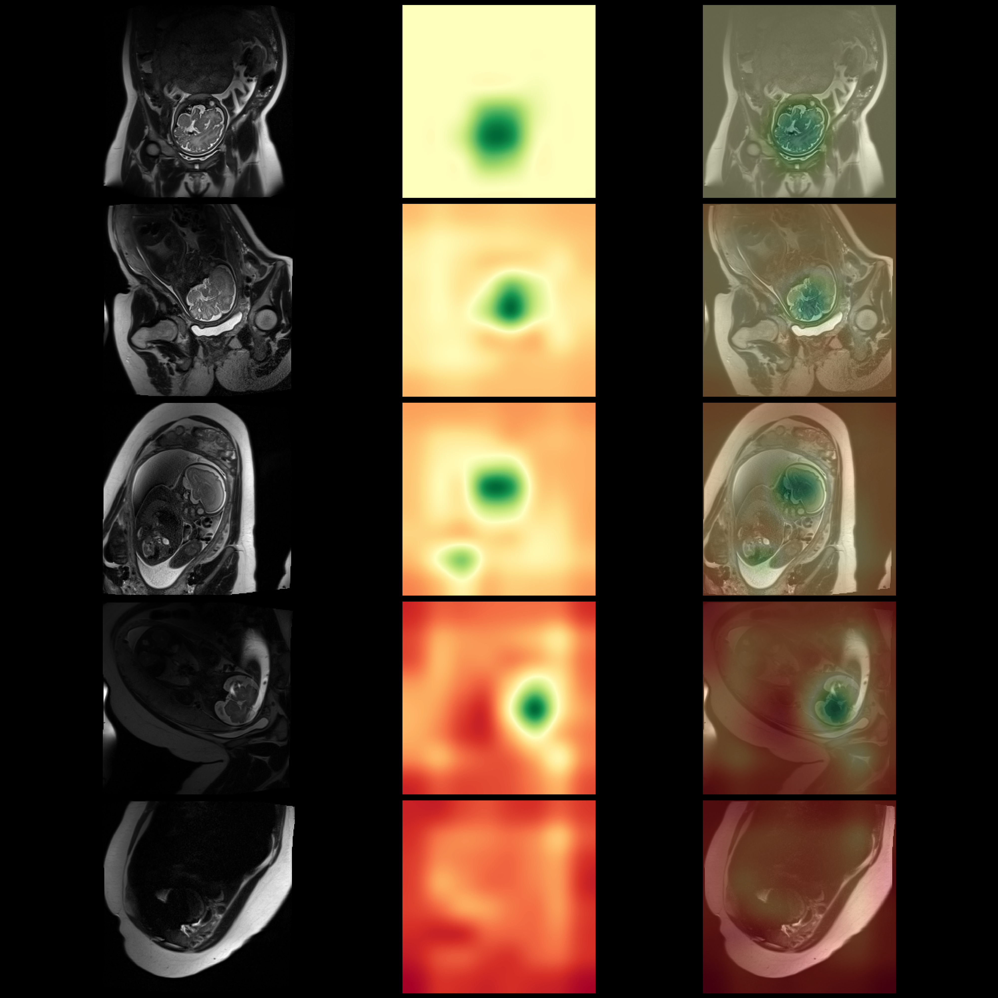
True label
CNN_IQA
score and label
Grad-CAM
Grad-CAM overlaid
Normalized Grad-CAM activations
0.00
Good, 0.00
0.26
0.59
0.93
1.00
Bad, 1.00
Notes:
How the saliency map gradually changes as a function of the classification score
Top to bottom, classification score is increasing meaning the classifier increasingly thinks the image is poor quality
As the classifier score increases i..e, probability that image is poor quality, positive activations from the rest of the image increases and negative activations coming from the brain decrease

Slide 26
Insights from saliency maps
Normalized Grad-CAM activations
As classification score moves toward good quality, grad-CAM activations become negative and concentrated on the brain
True label
CNN_IQA
score and label
Grad-CAM
Grad-CAM overlaid
0.00

Slide 27
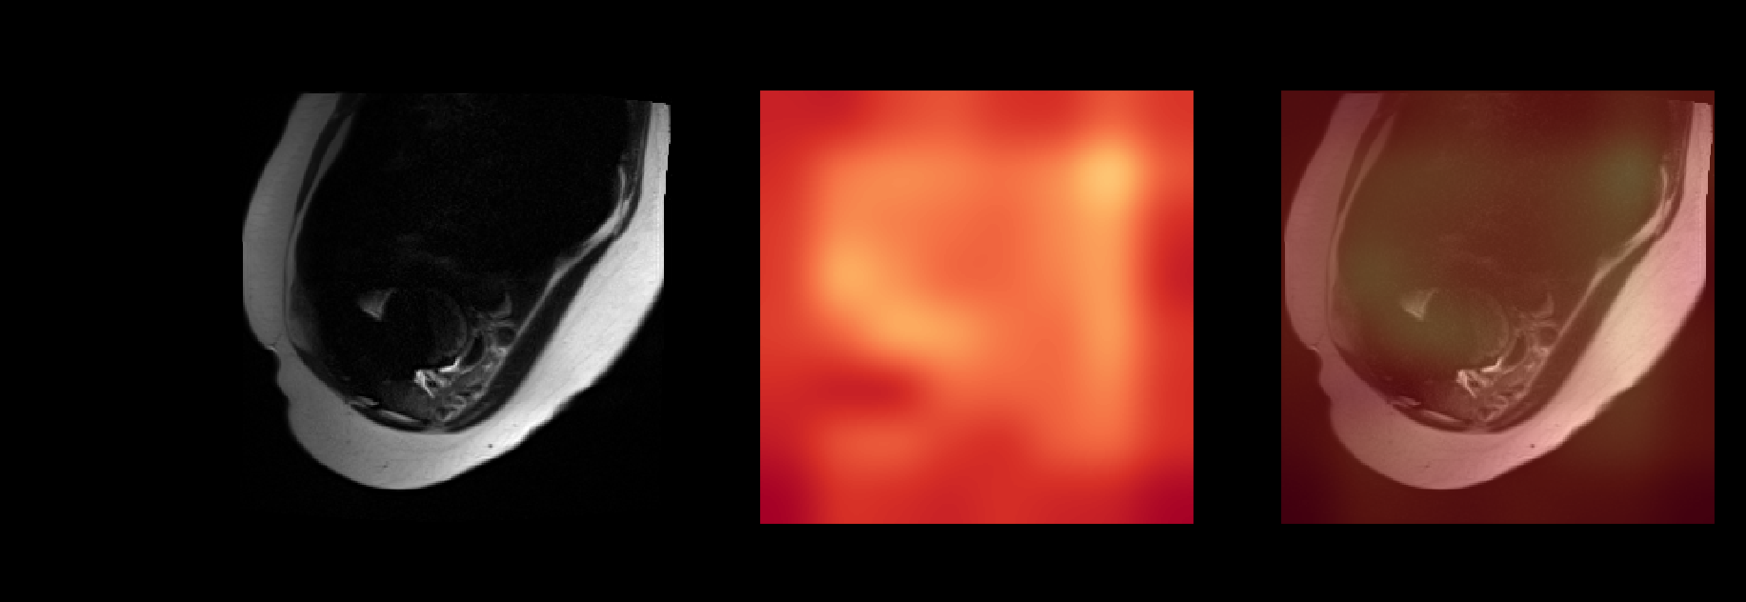
Insights from saliency maps
Normalized Grad-CAM activations
As classification score moves toward bad quality, grad-CAM activations become positive and diffuse over the image
True label
CNN_IQA
score and label
Grad-CAM
Grad-CAM overlaid
1.00
Notes:
Speculate: The saliency map patterns suggest classifier is learning to identify good quality brains, rather than artifacts. If it doesn’t find a good brain, labels the image as bad quality.

Slide 28
Summary and Next steps
Trained and evaluated a CNN for T2W fetal brain MRI slice IQA
Plan to scale experiments on larger, representative dataset
Notes:
Demonstrated relatively good performance with smaps suggesting classifier may be learning what a good quality brain looks like
New trove of data with rich variations in pathologies, singletons vs twins, improve classifier generalization

Slide 29
Summary and Next steps
CNN image evaluation takes 20 ms on a GPU makes it feasible for low-latency detection during the scan
Implement on the scanner
Could be used towards improving current protocol and for automated slice prescription

Slide 30
Acknowledgments
NIH R01 EB017337 and U01 HD087211
NIBIB 5T32EB1680
NVIDIA Corporation GPU grant program

